Slide 1
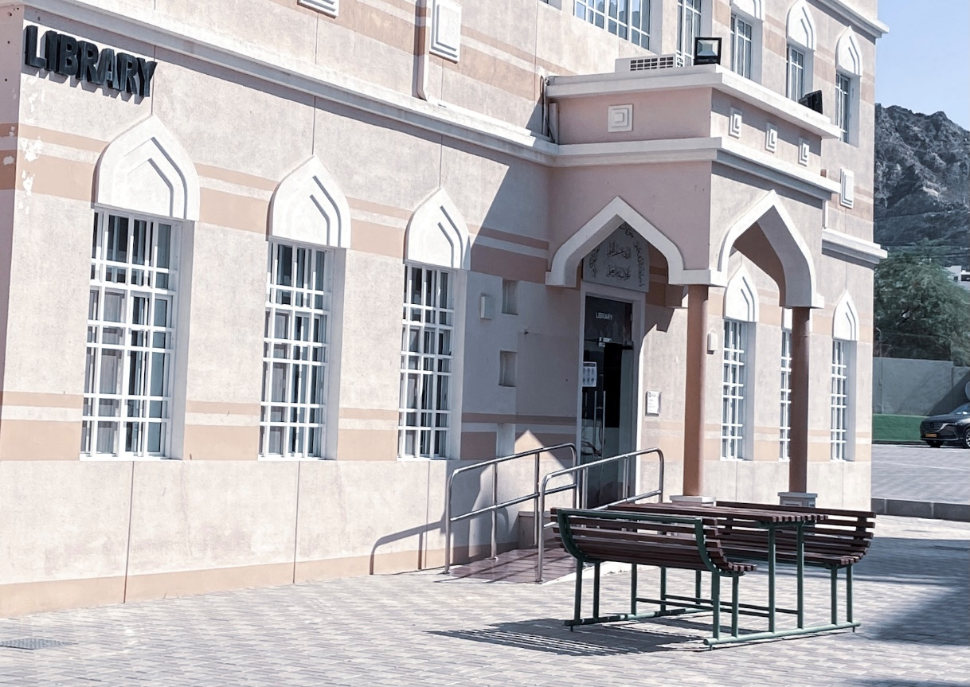
WELCOME TO
MAJAN COLLEGE LIBRARY

Slide 2
Library Information
Opening Hours:
From 8:00 a.m. to 8:30 p.m. Sunday to Wednesday .
From 8:00 a.m. to 3:00 p.m. on Thursday.
Location: Bustan Al Marifa
Contact Details: Tel: +968 24730443 / 413 Email: library@majancollege.edu.om
WhatsApp; 93691208

Slide 3
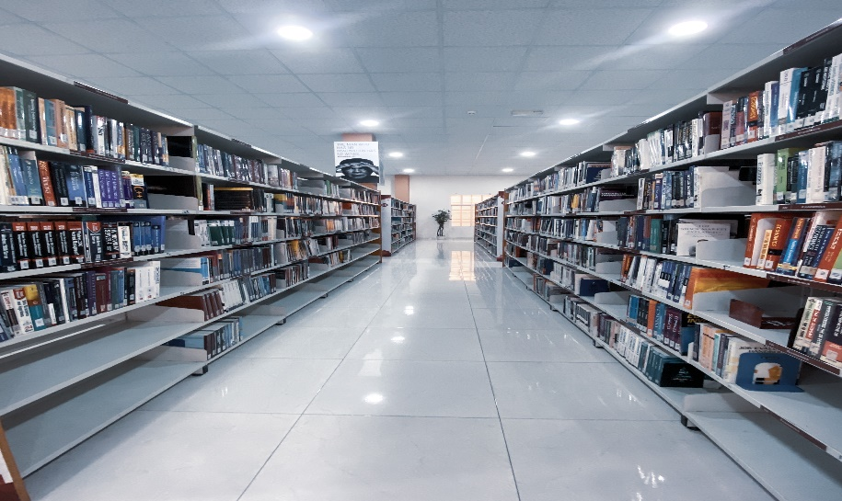
Library Services
Borrow books
Use printers.
Use the photocopier (RO 0.100, 1.000,3.000 for recharge credit) Online Payment or cash.
Use computers
Using online resources (Masader)
Student ID card is needed for borrowing and renewing books

Slide 4
Borrowing books
You must have a student ID card
You can borrow 4 books for 2 weeks (Foundation)
You should take care of borrowed books
Do not lend your card to anyone else to use.
If let us know if you lose your card
Check your college email daily. All notices will be sent to this email address.
Note
Renewing books and fines
Return borrowed books or renew them on time
You pay 100 Baisas per day, per book if returned late.
You can renew at the information desk and via MUC library portal.
You will need your student number.

Slide 5
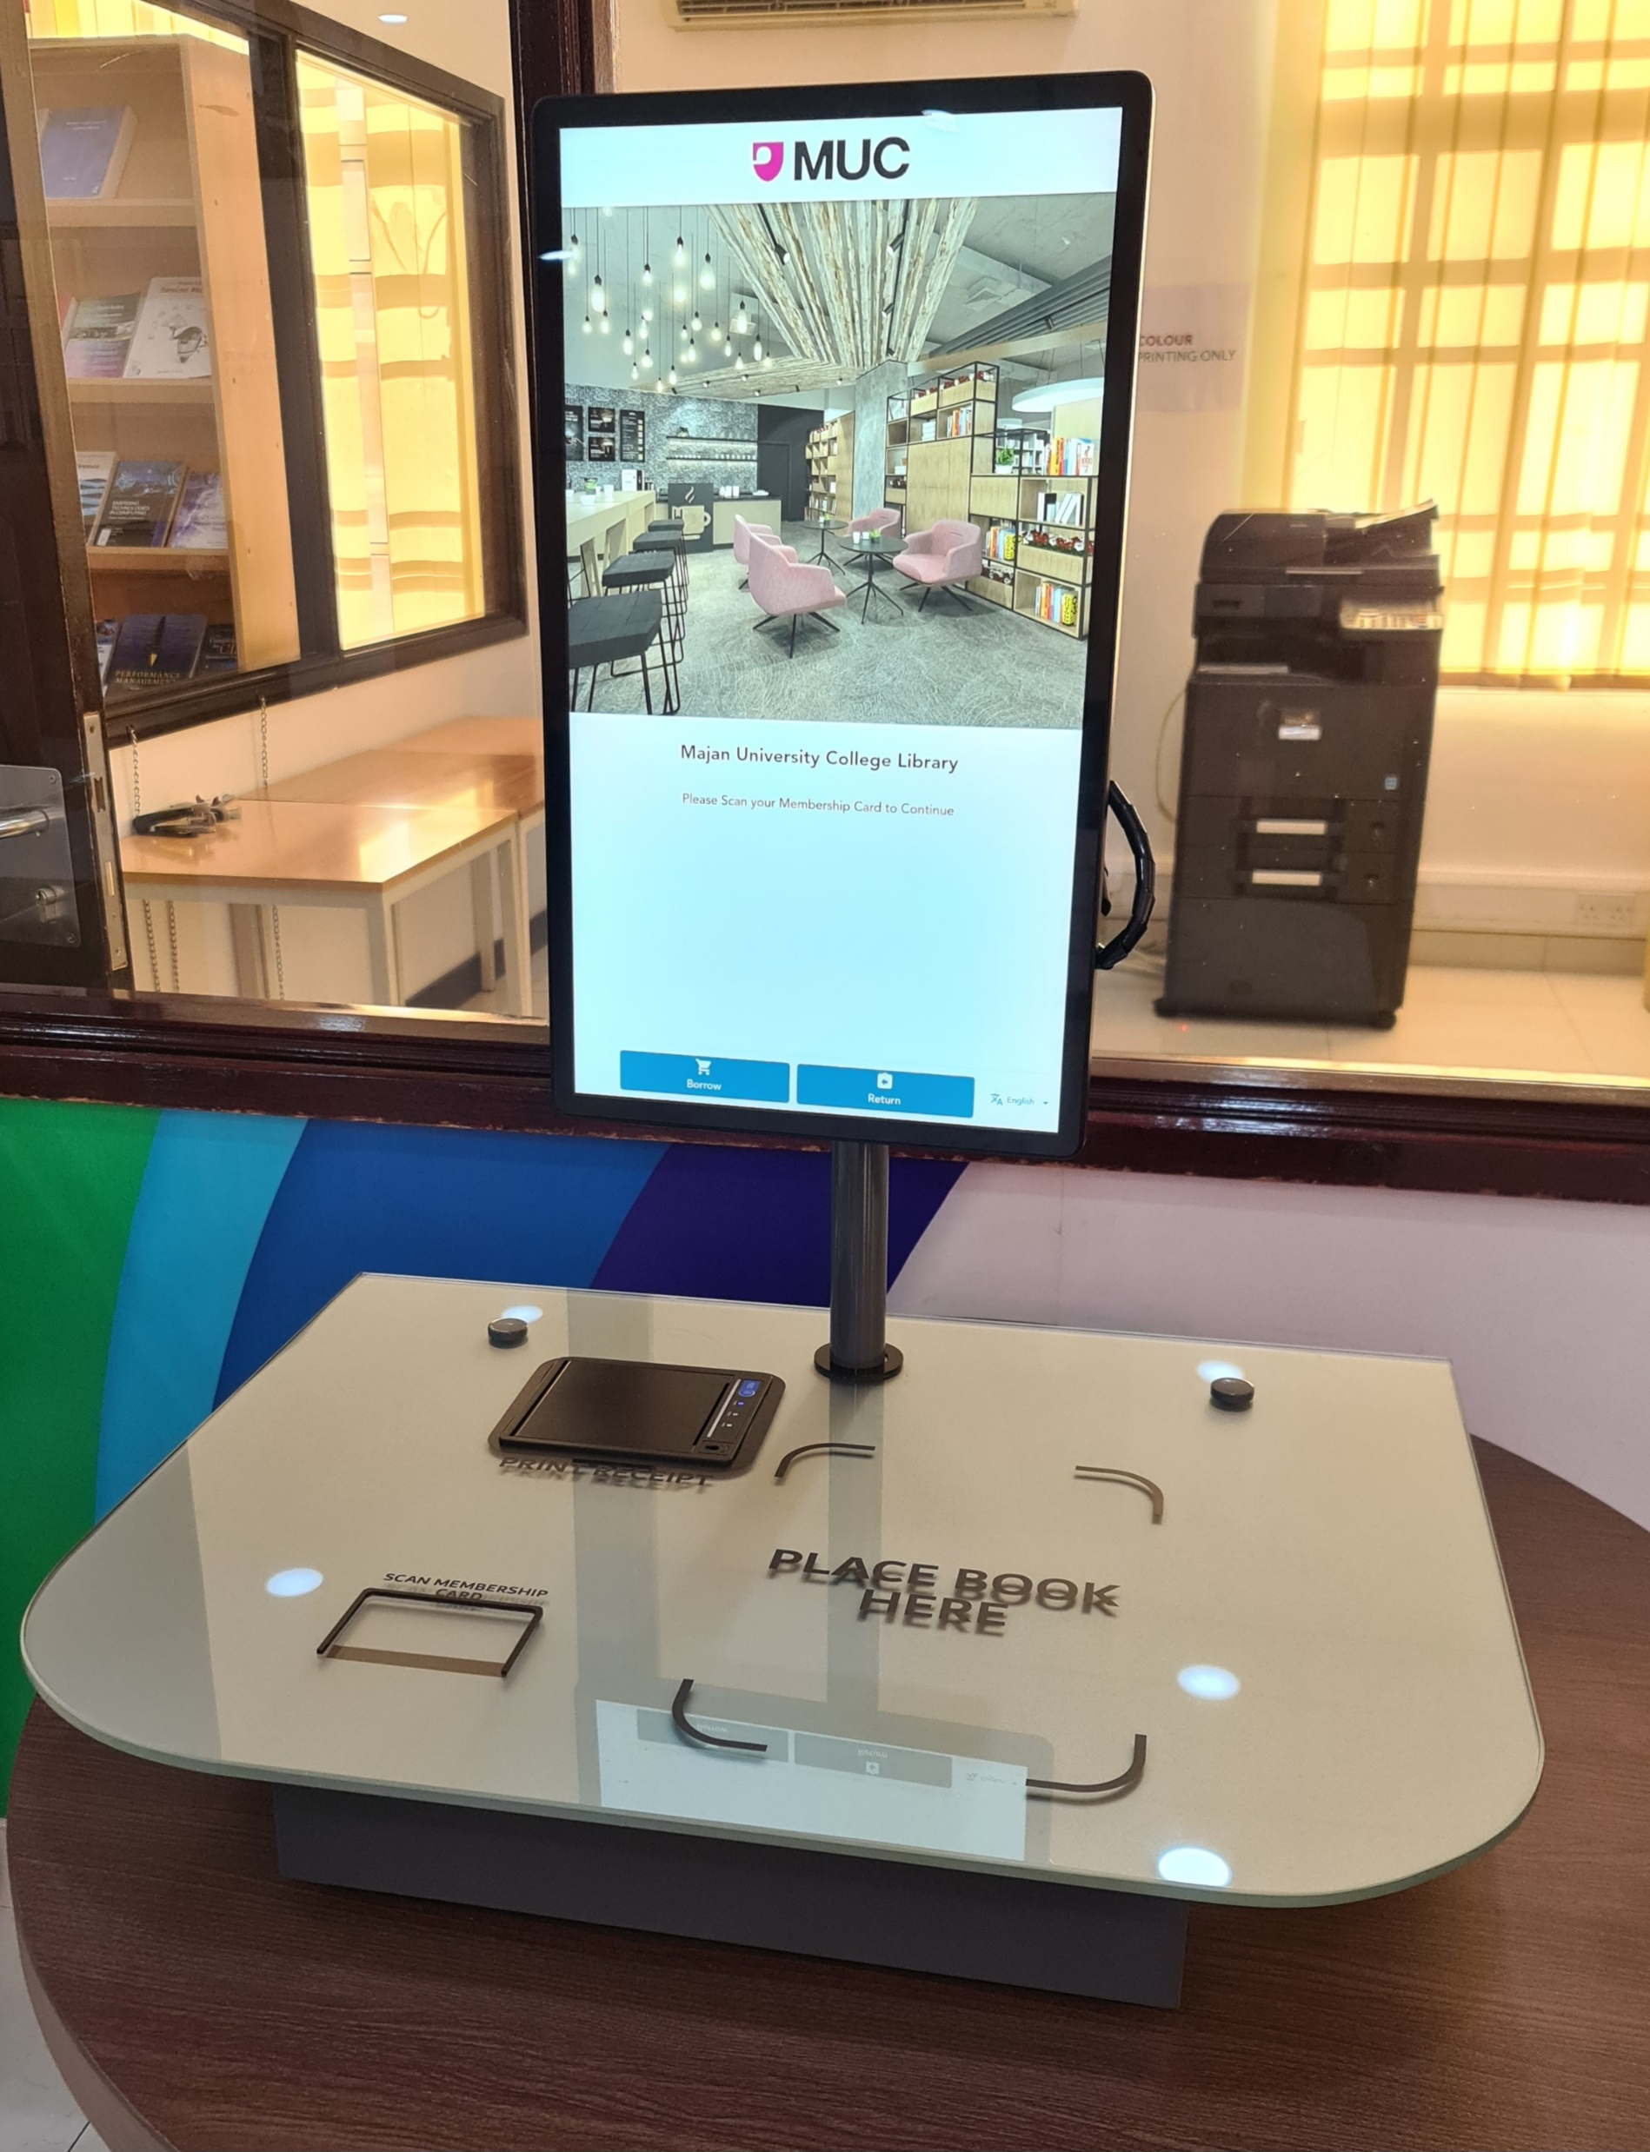
Self Service station

Slide 6
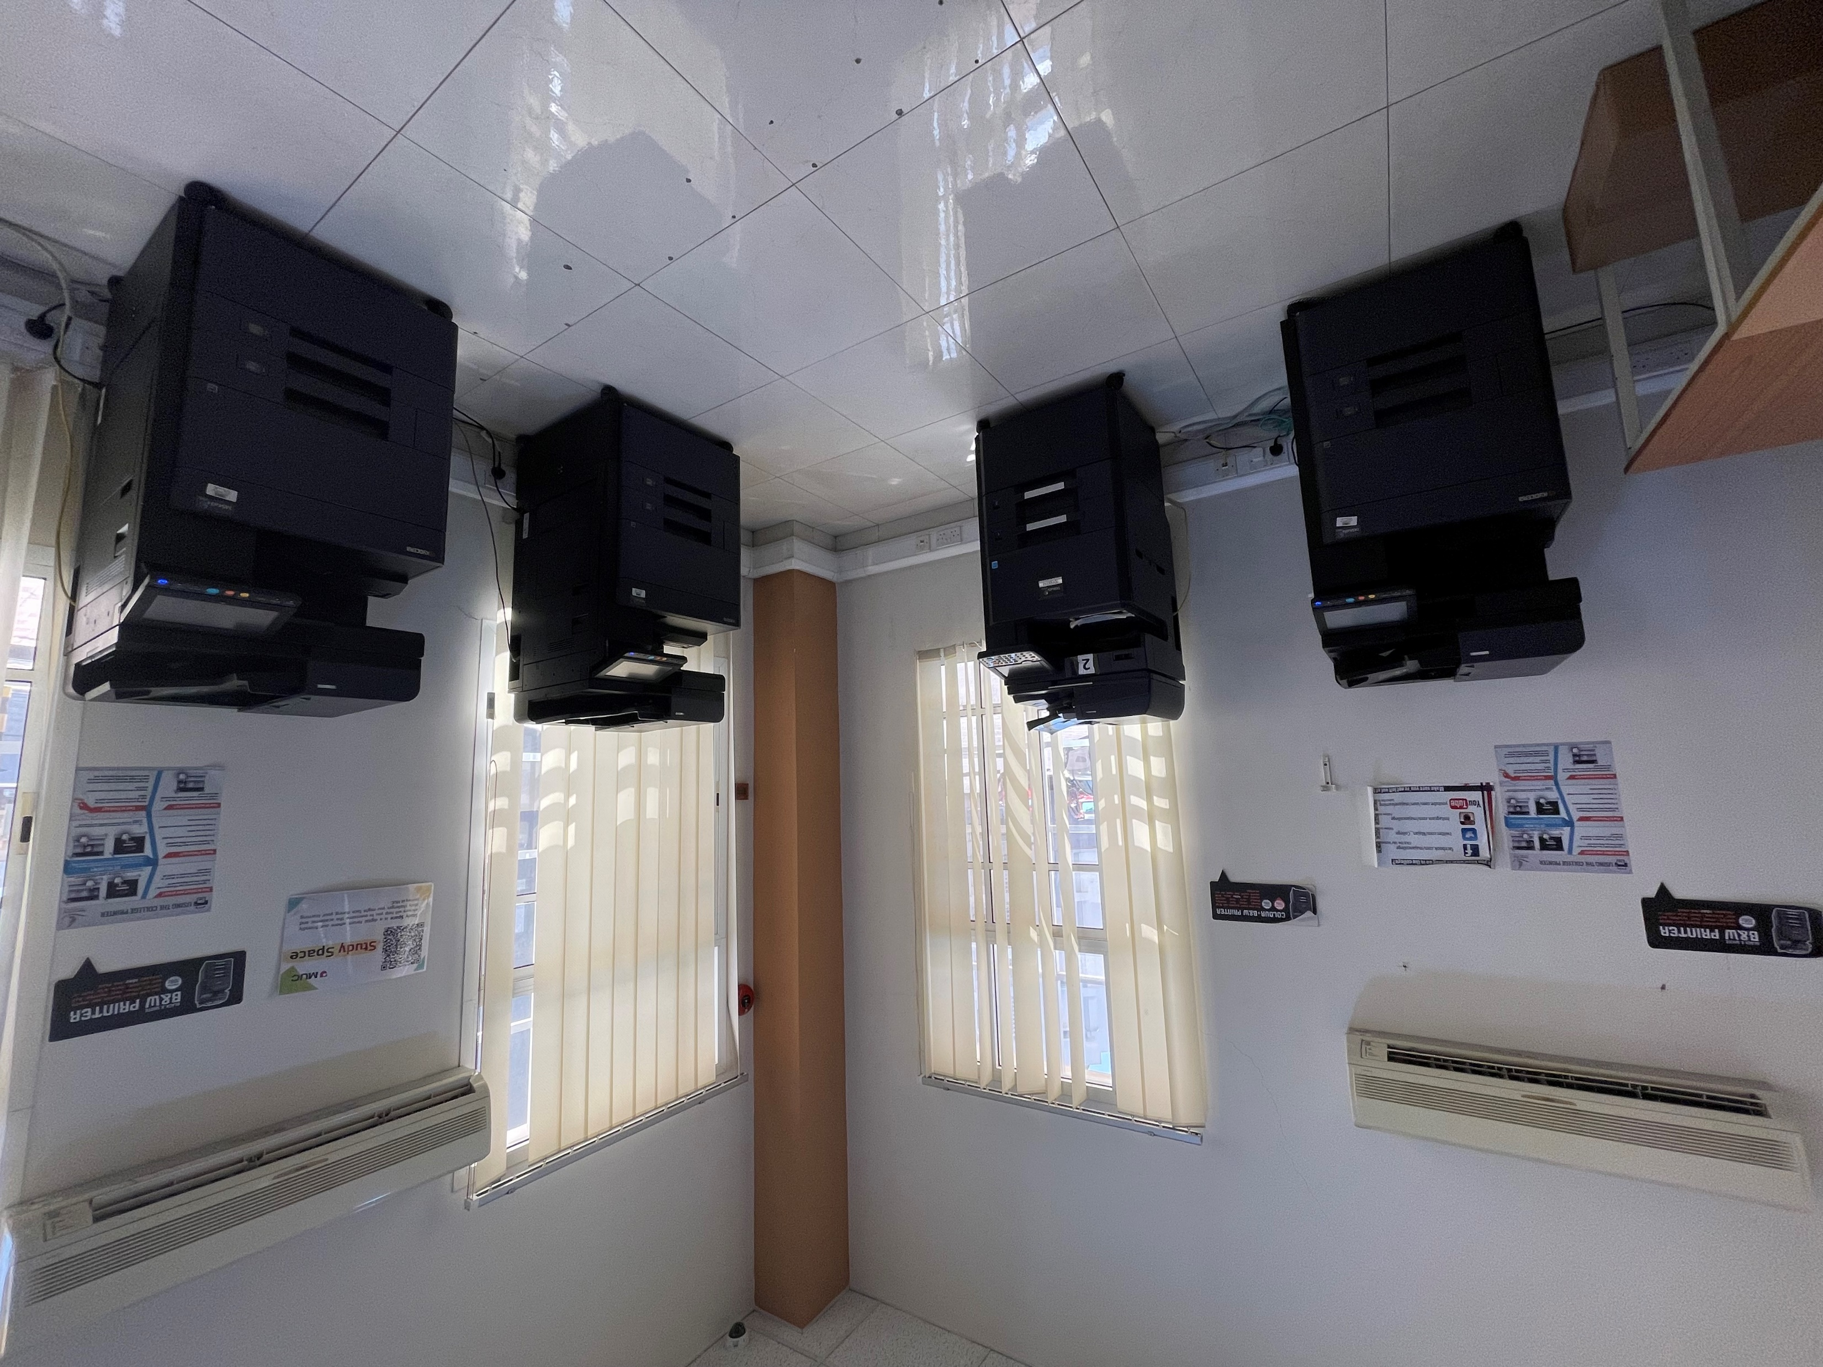
Photo copying, Printing and Scan services
Four self-service photocopiers are available.
Use your Student ID card number to operate.
You can scan documents.
Photo copying, Printing.
Scan services are also available in Black & White and color.

Slide 7
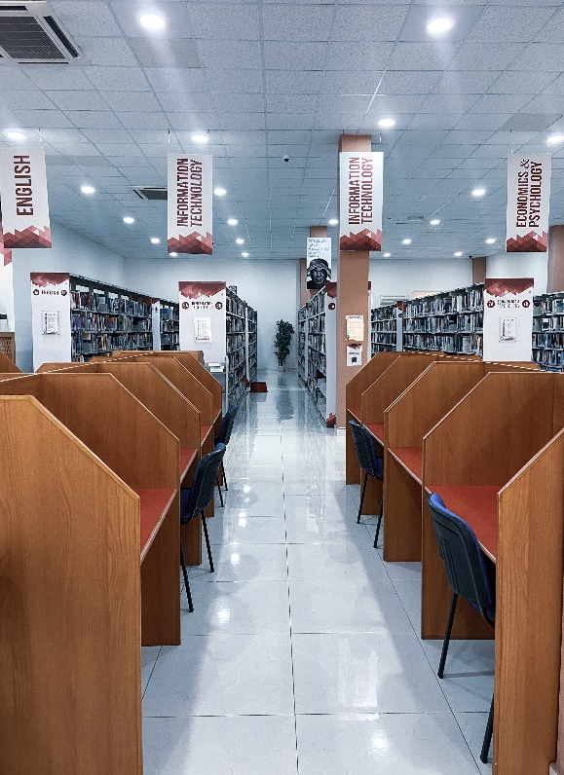
While in the library
Do not sit and chat with your friends.
Switch your mobile phones to silent
Do not eat or drink. (bottled water is acceptable)
Do not talk loudly
Be quiet and respect other library users

Slide 8
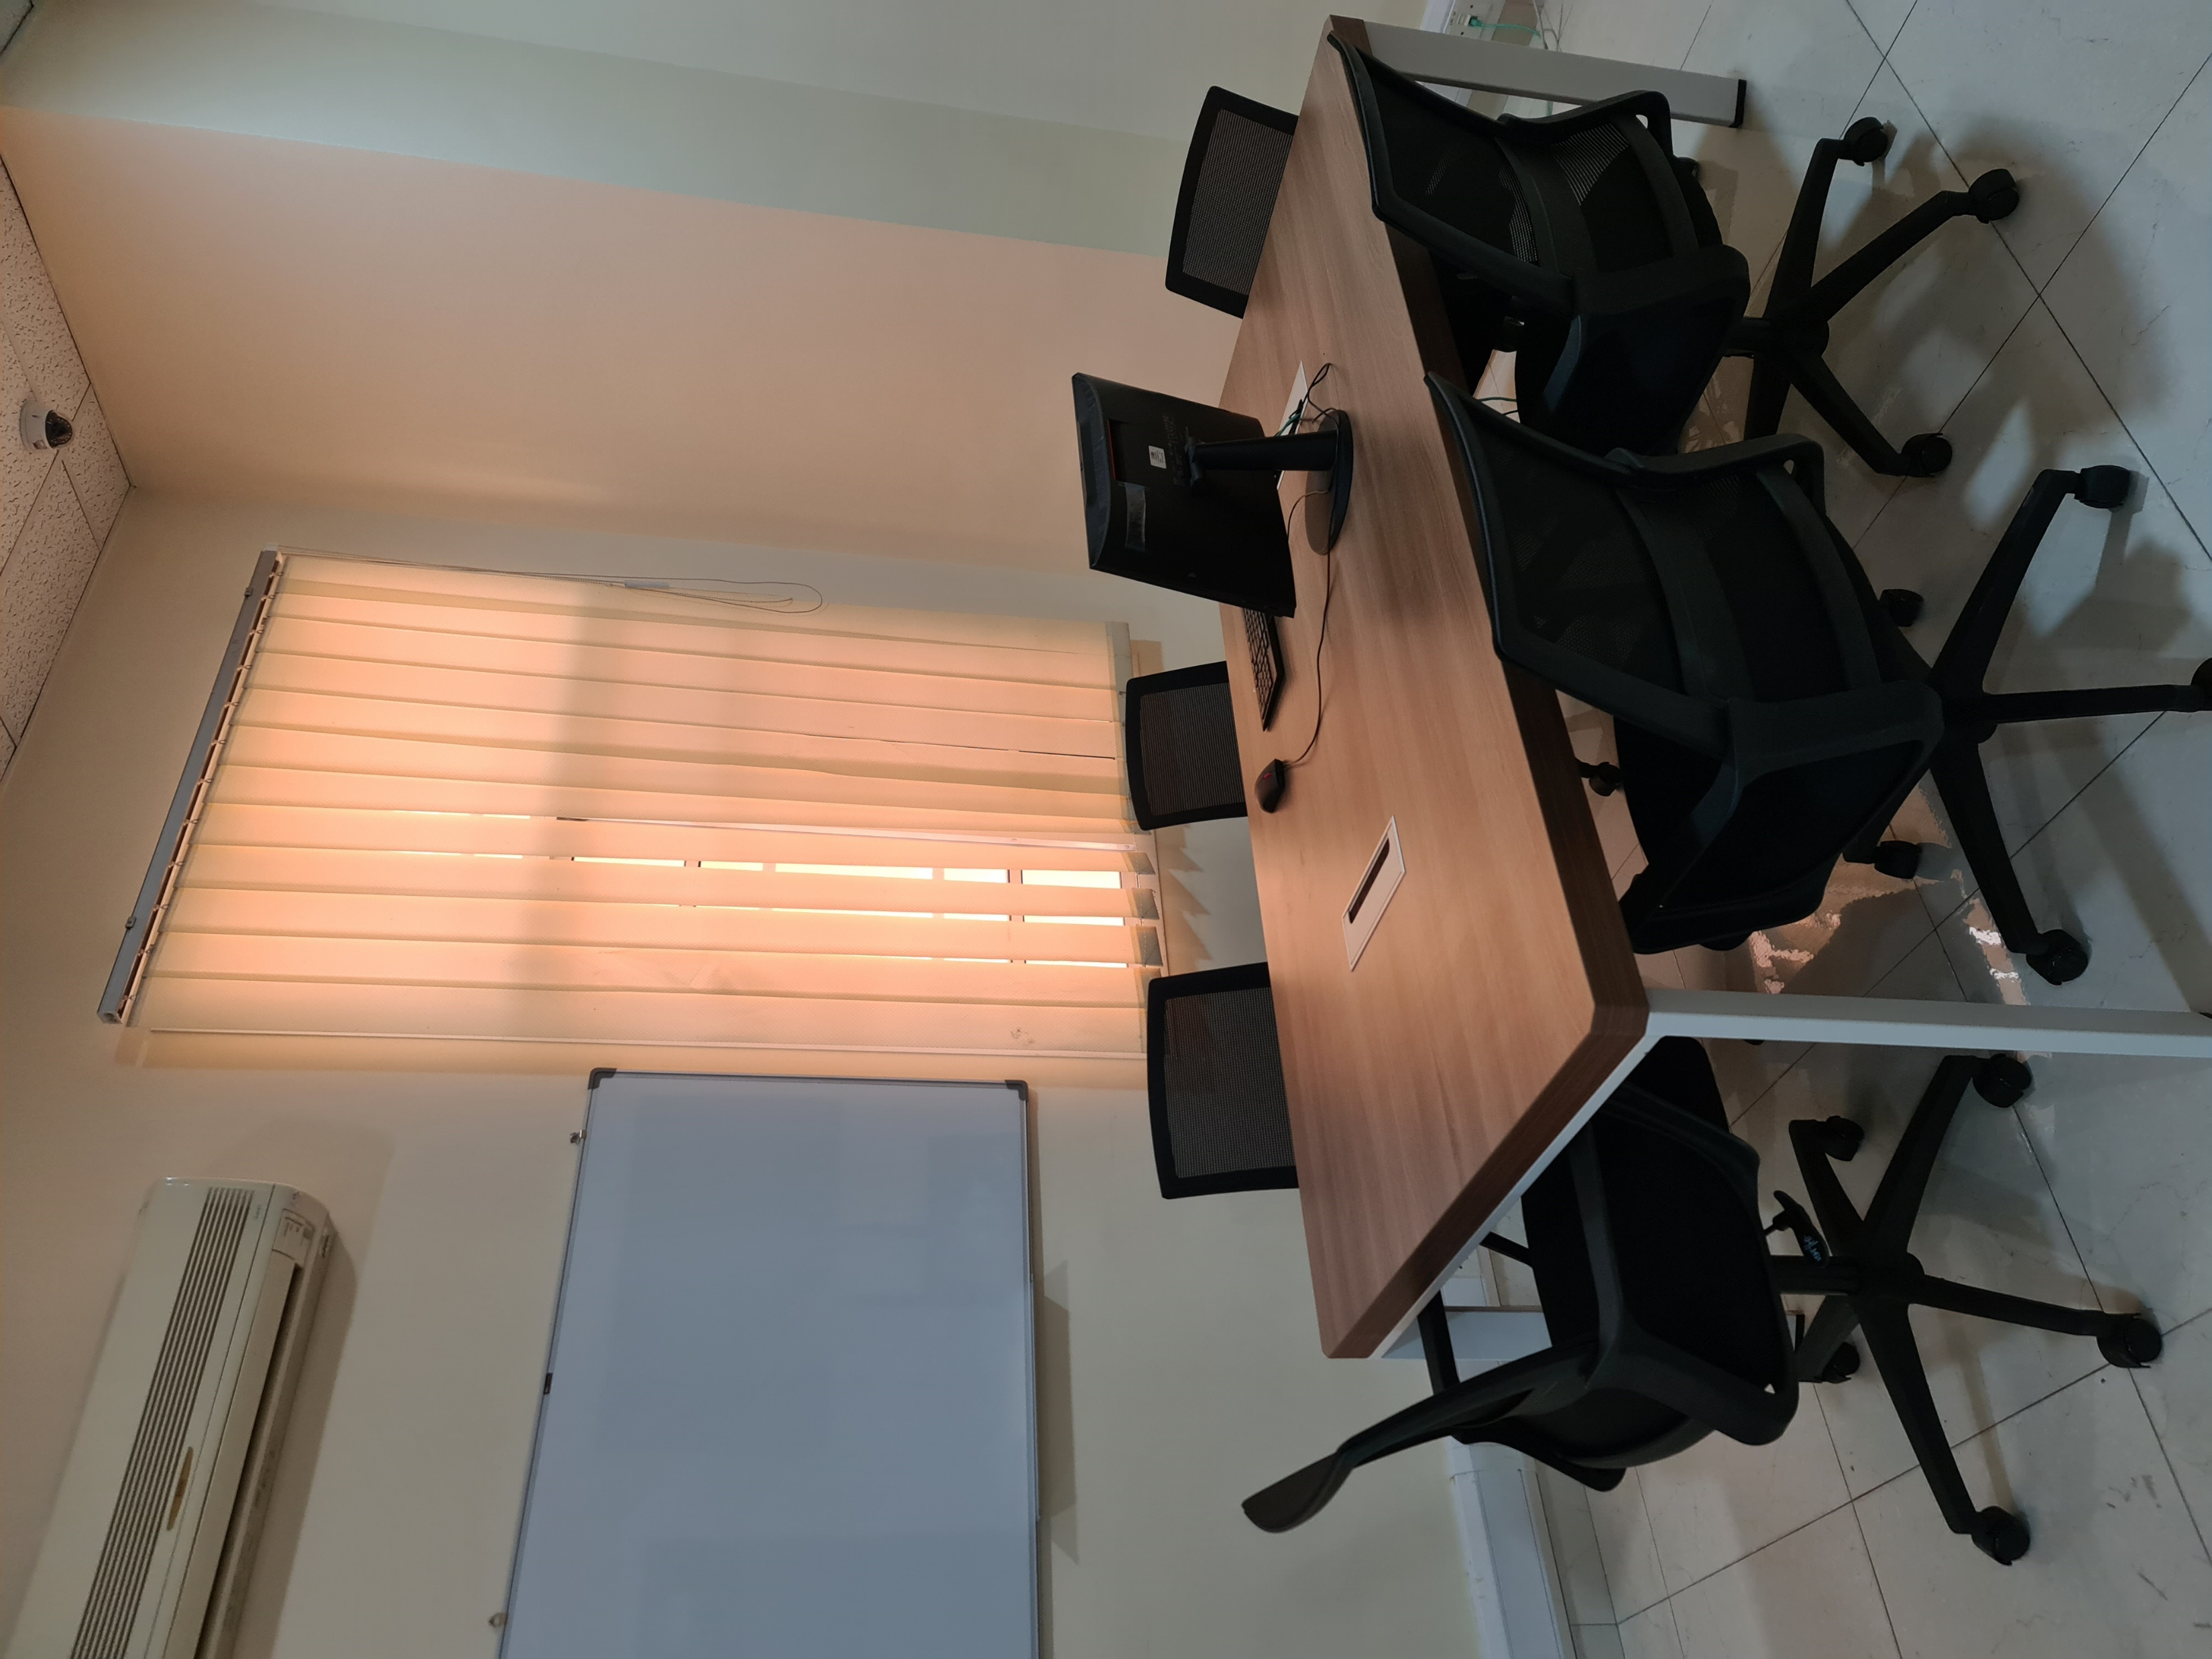
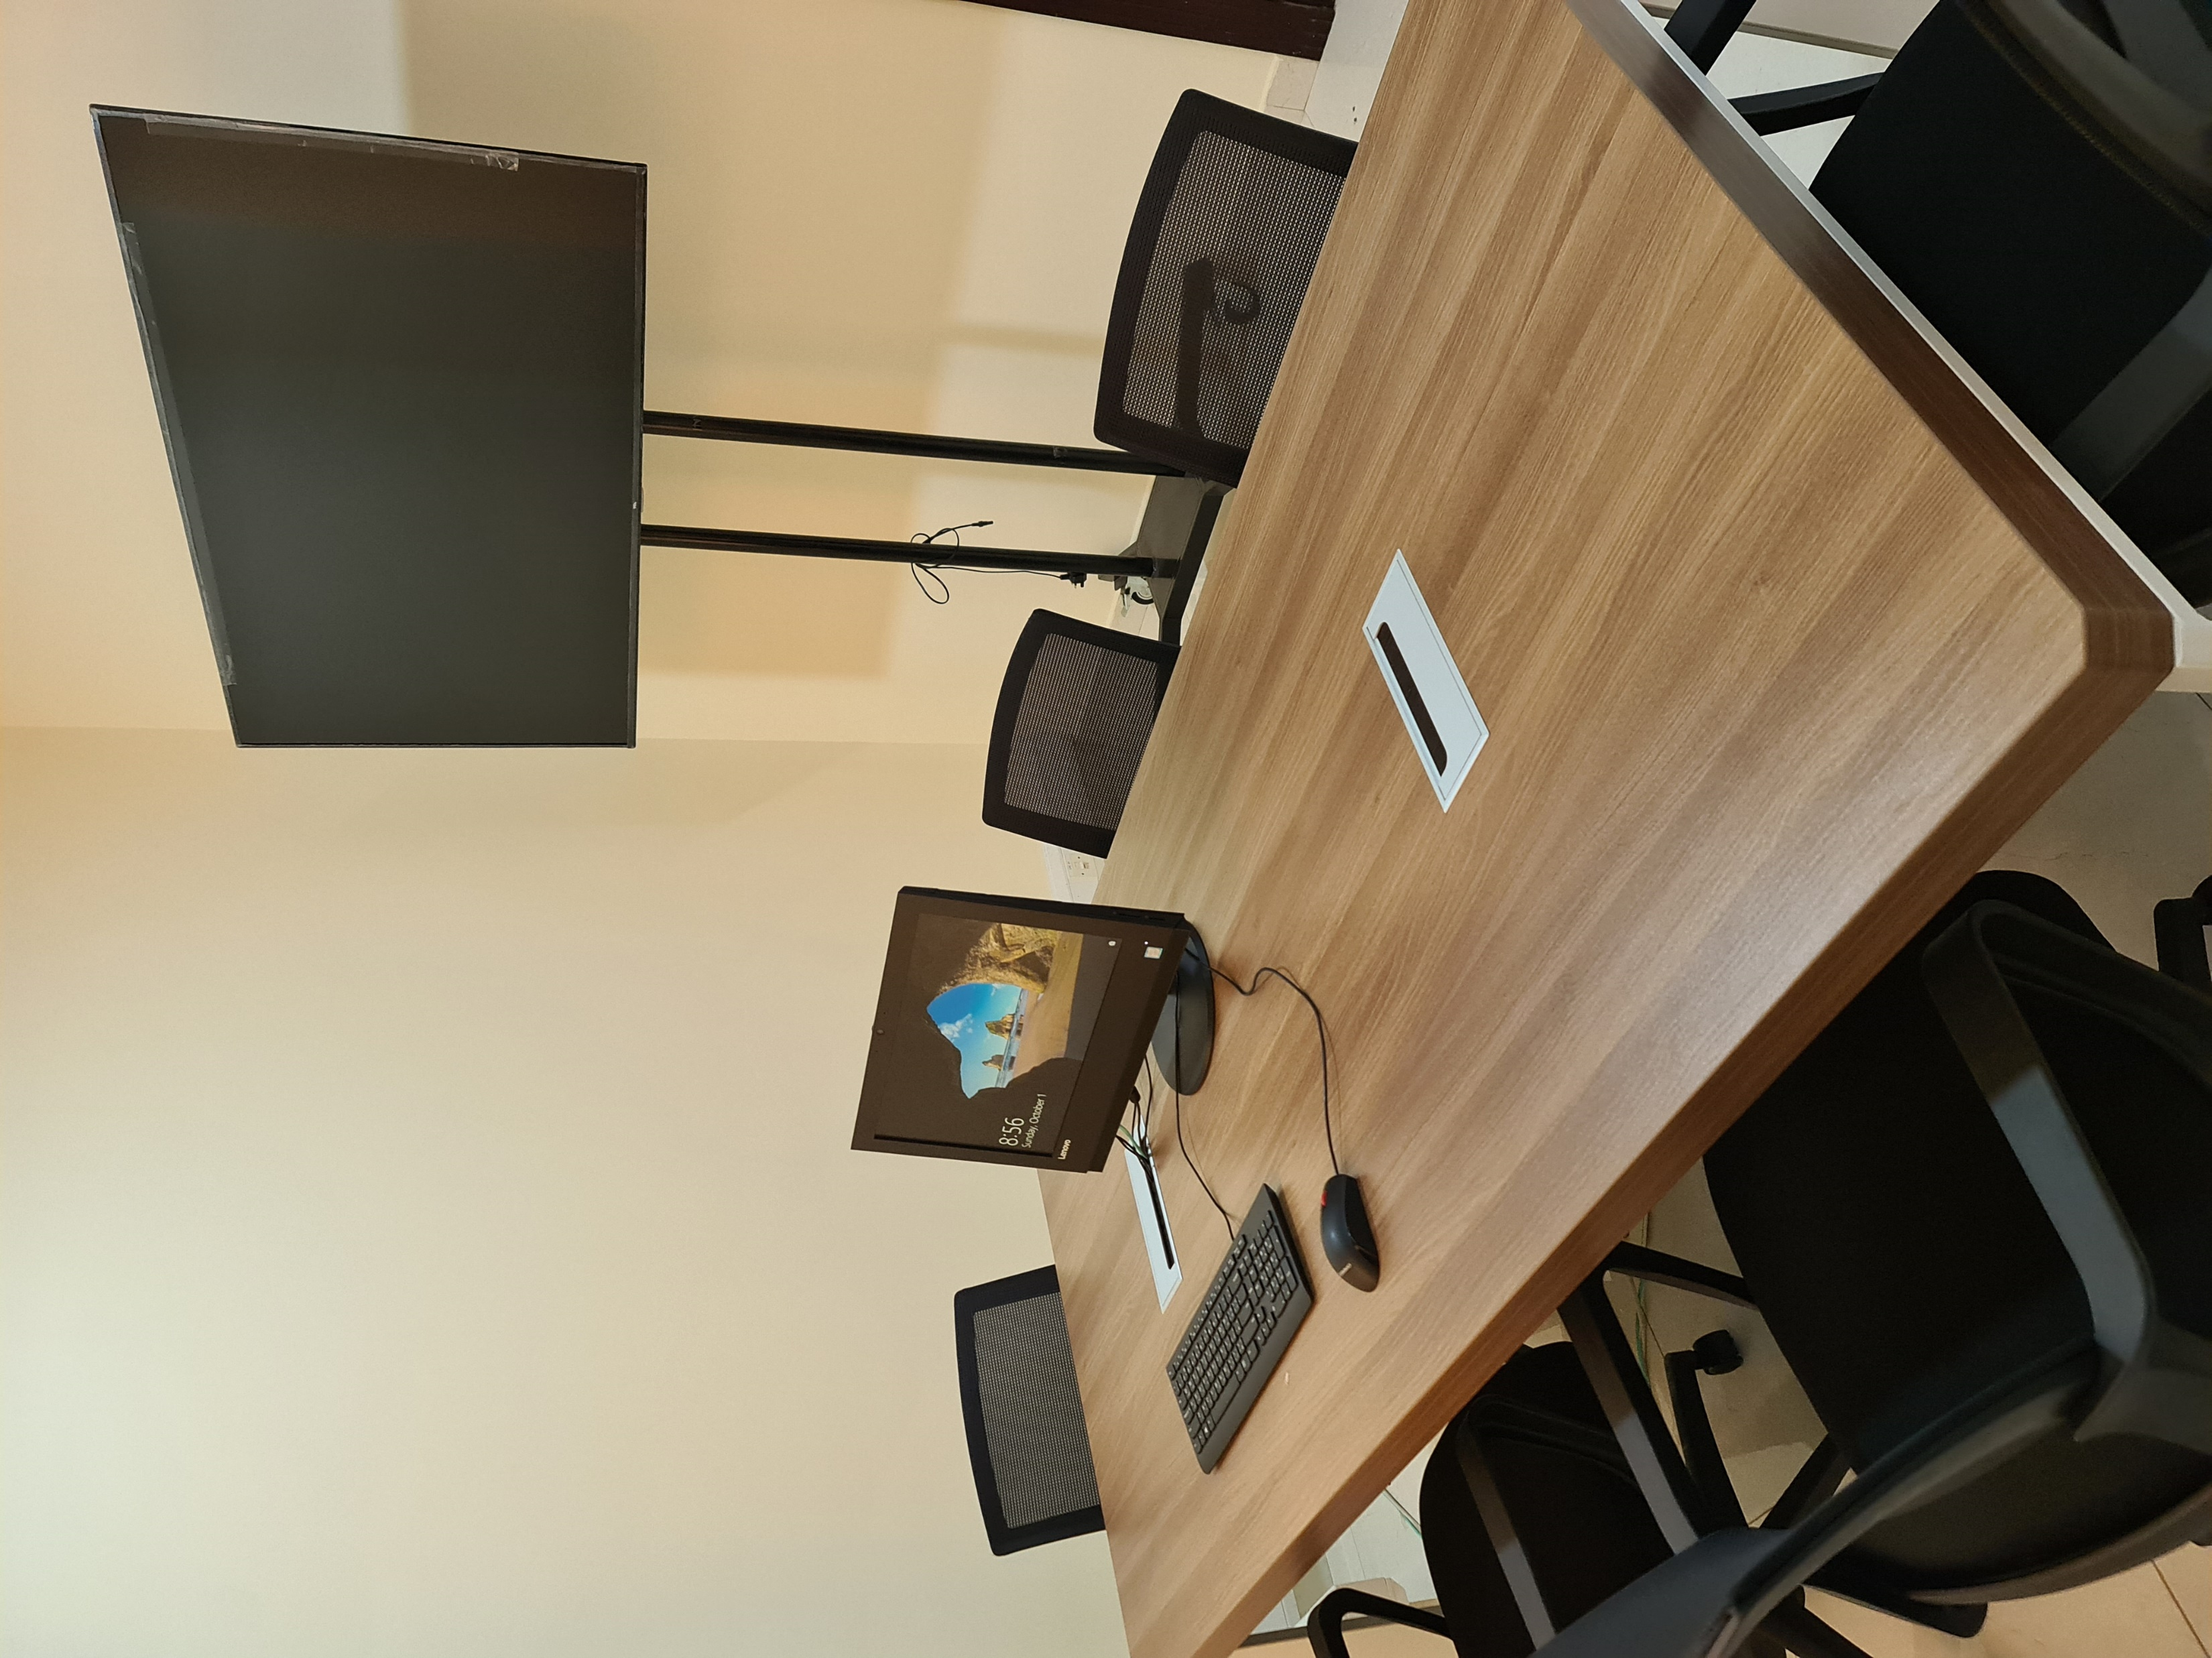
Think Cube
In the LRC
The Think Cube has been created to support MUC students in various activities,
including group study, group discussions, and tutorials. To reserve this room, kindly visit
the Library Helpdesk.

Slide 9
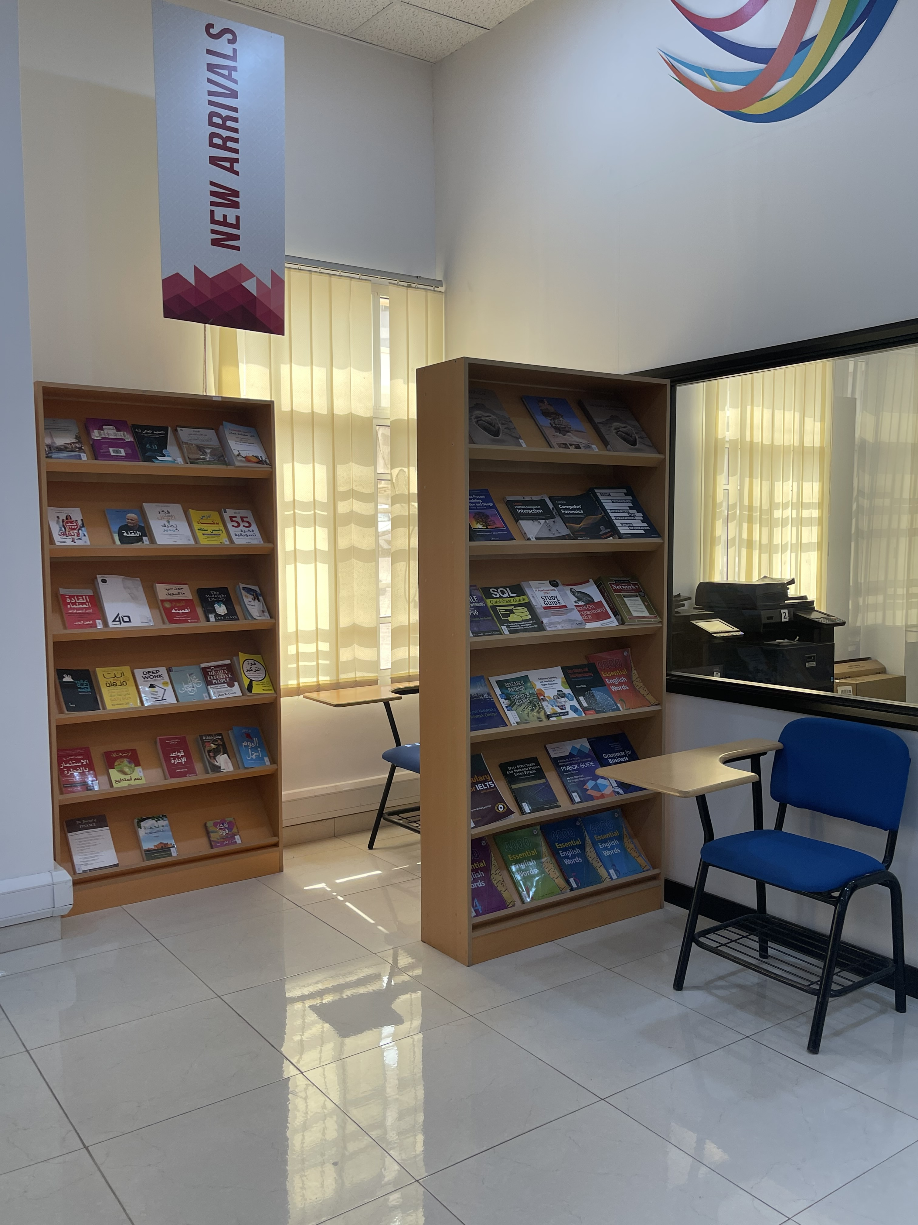
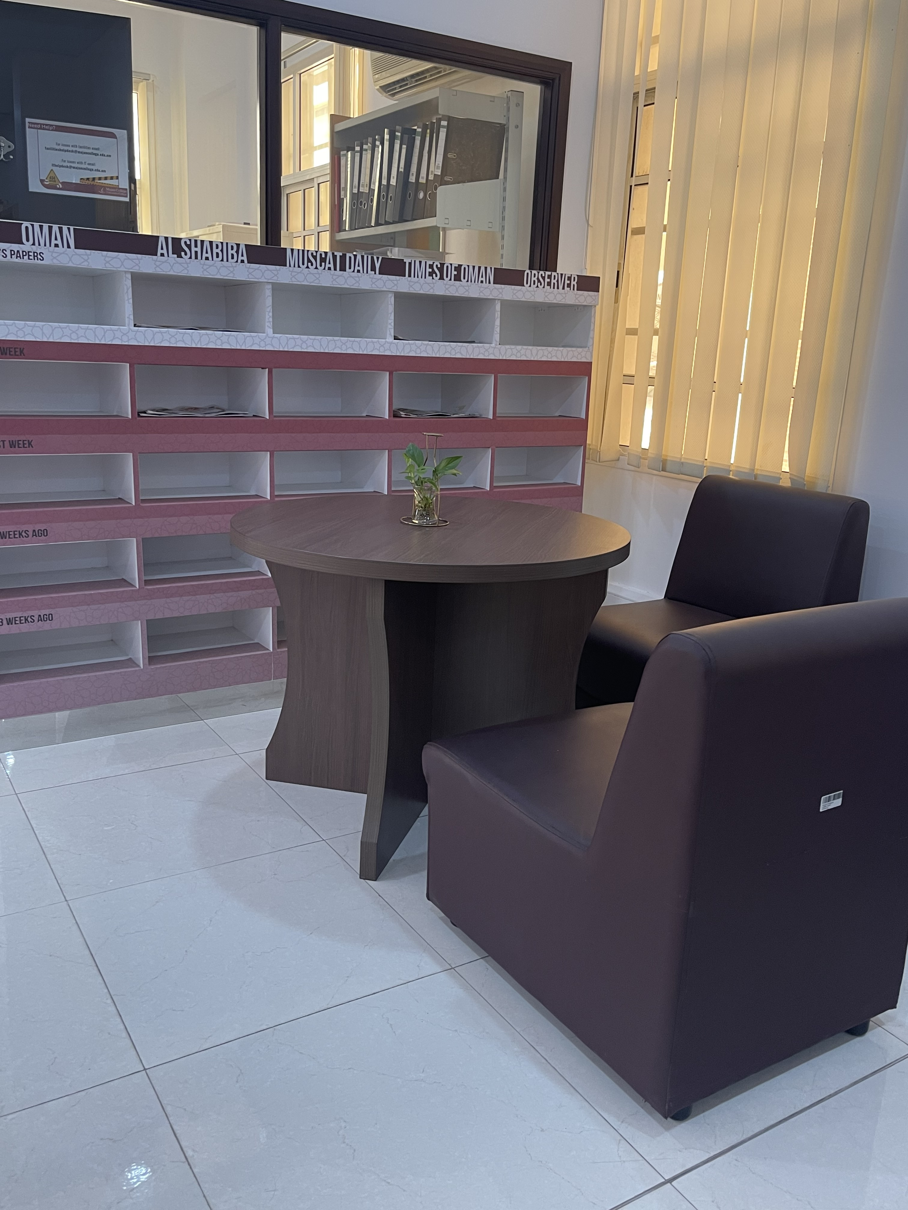
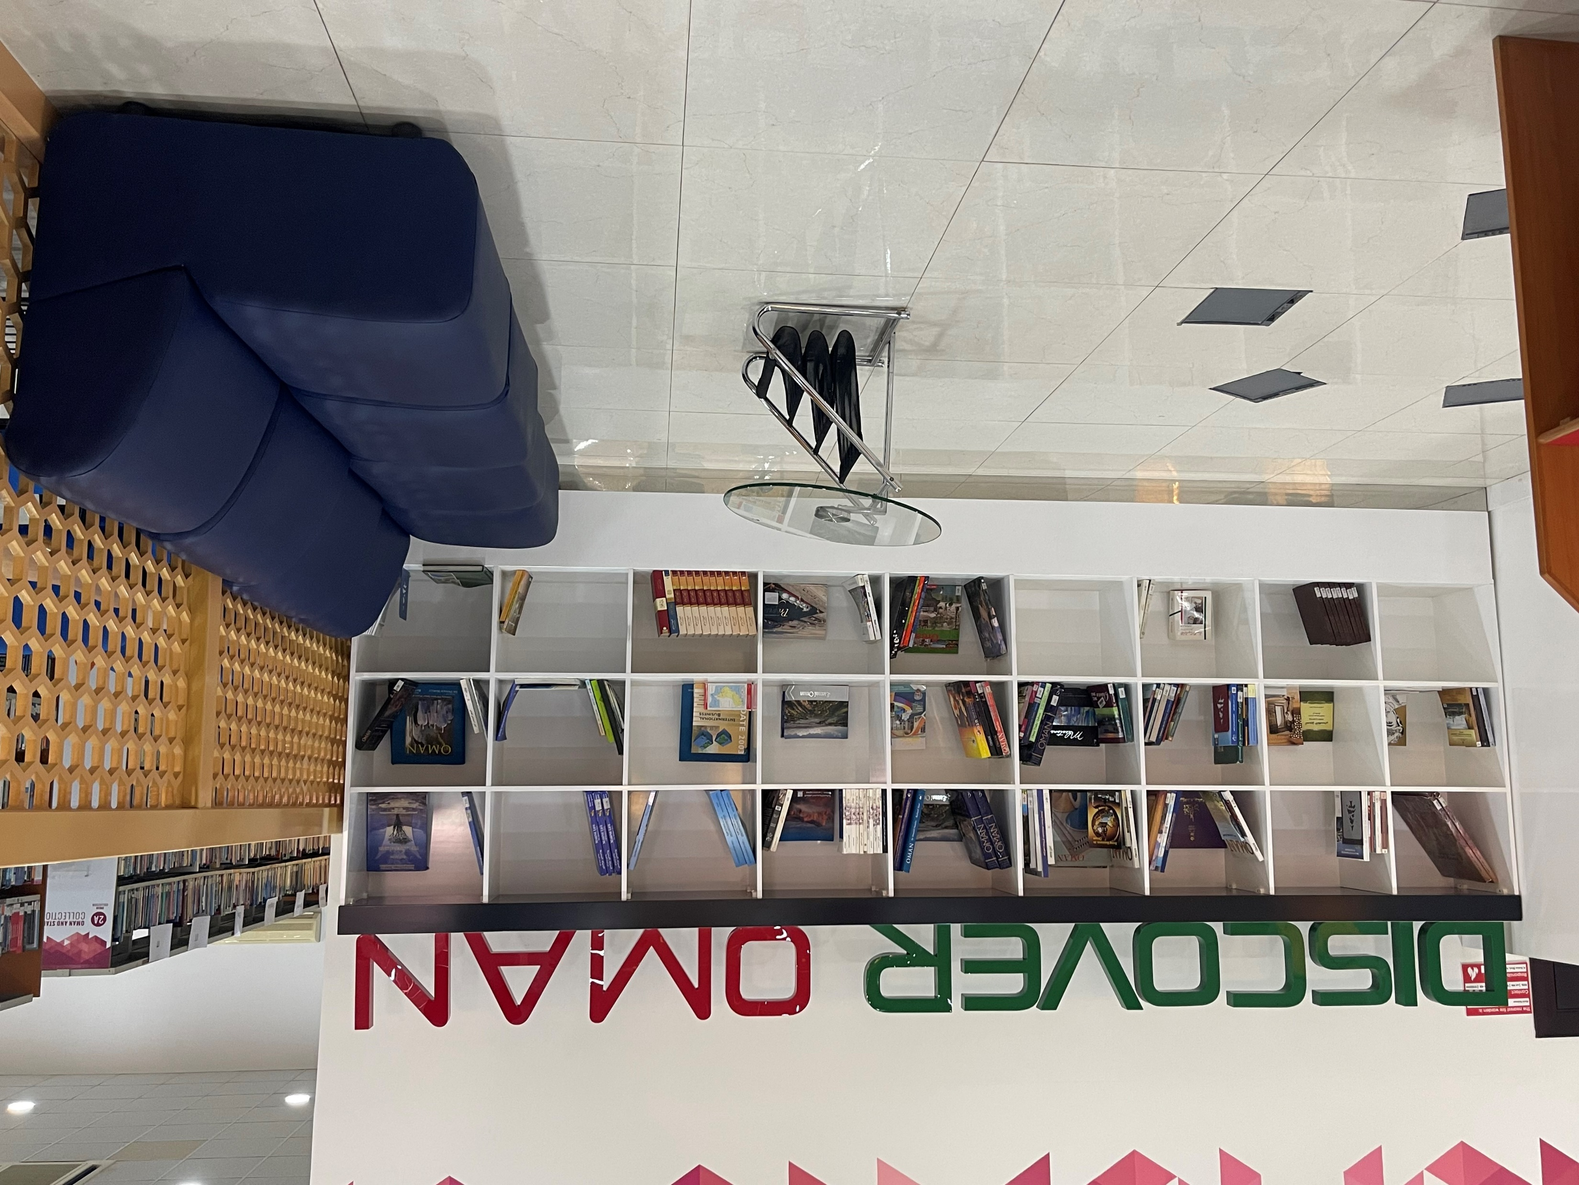
Discover Oman section &New arrivals & daily news paper

Slide 10
Who can I ask for help ?
All library staff will help you
Mrs. Maha AL_Zadjali
Mrs. Asma AL_ Ghielani
Ms.Maha AL-Araimi

Slide 11
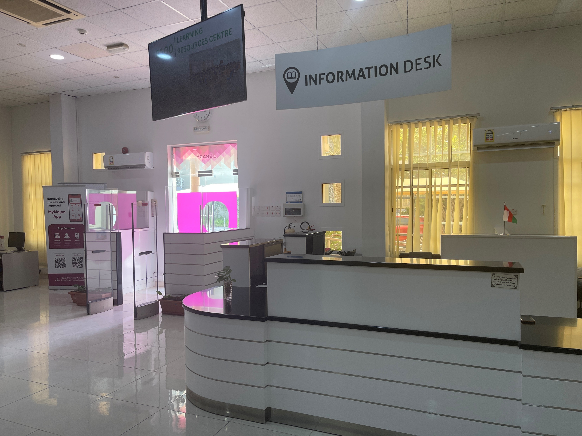
Information Desk
Services include: -
General queries
Help and advice regarding library resources
Training sessions on how to use electronic library databases and e-journals etc.

