Slide 1
Huawei ICT Competition 2024-2025 Middle East & Central Asia

Slide 2
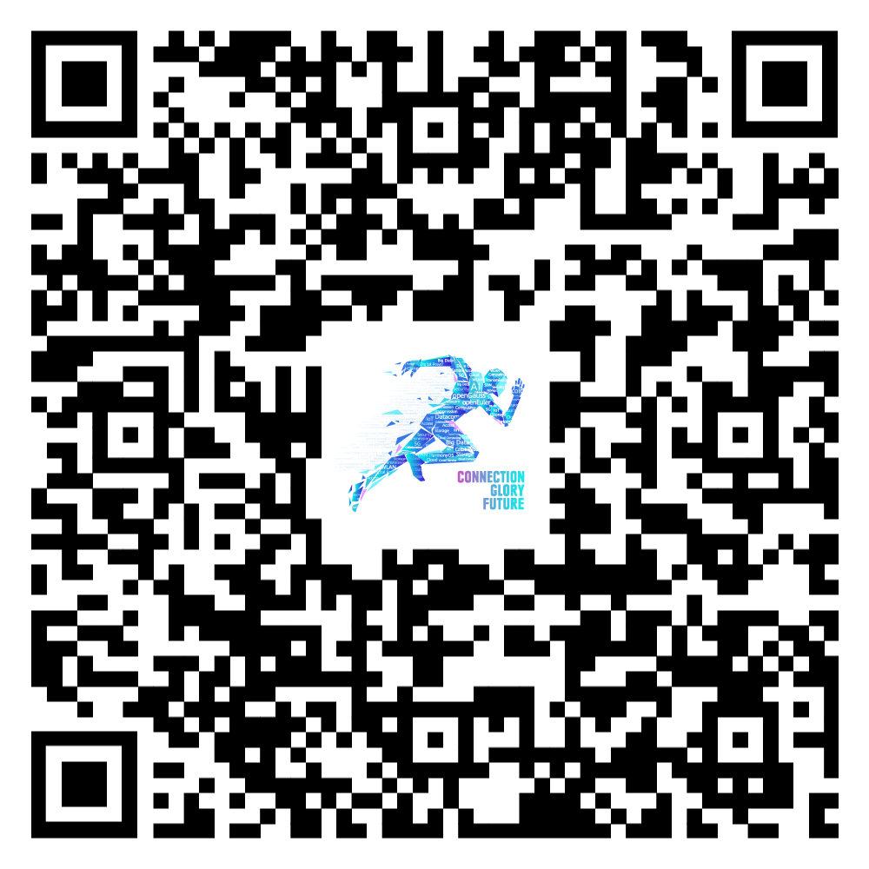
Huawei ICT Competition——Connection, Glory, Future
With the theme of “Connection, Glory, Future”, the Huawei ICT Competition will gather governments, higher educational institutions, training institutions, and industry enterprises, to promote the cultivation, growth, and employment of ICT young professionals from universities and colleges, helping the ICT talent ecosystem thrive.
Regional Final
Roadshow & Enrollment
Dec. 2024
Aug. – Nov. 2024
Kick Off
Aug. 2024
Global Final
May. 2025
Shenzhen, China
National Competition
Oct - Nov. 2024

Slide 3
Huawei ICT Competition Middle East 2024
August 2024
Oct 2024
Nov 2024
Dec 2024
Competition Timeline
Launch
Preliminary
National Final
Regional Final
Network Track
Datacom
Security
WLAN
DCN
Cloud Track
Cloud
AI
Big Data
Computing Track
openEuler
openGauss
Kunpeng

Slide 4
Three Competition Levels
Preliminary |  | National Final |  | Regional Final
Written Exam 60 questions, 90 minutes |  | Written Exam 90 questions, 90 minutes |  | Written Exam + Lab Exam 60 questions, 60 minutes + 4 hour Lab
National Competitions (Individual /Team competition):
Participants must be enrolled college students with access to a PC and the internet.
Each participant is allowed to enter only one track per year.
From the National Finals through to the Global Finals, the competition will be conducted at the team level. It is recommended that all team members are from the same university.
Grand Prize winners from previous Global Finals are eligible to compete again, provided they enter a different track.
In the preliminary competition of each country, participants who hold valid Huawei certifications will receive bonus points. （It is recommended to use the competition learning space to access previous learning materials.）
HCIE Certificate: 200 points;HCIP Certificate: 100 points; HCIA Certificate: 50 points; (Points can be accumulated, and the upper limit of bonus points cannot exceed 200 points.)
Regional Finals (Team competition):
The Regional Finals are team competitions, with teams advancing from the National Finals. Team members must remain consistent, and substitutions are generally not permitted.

Slide 5
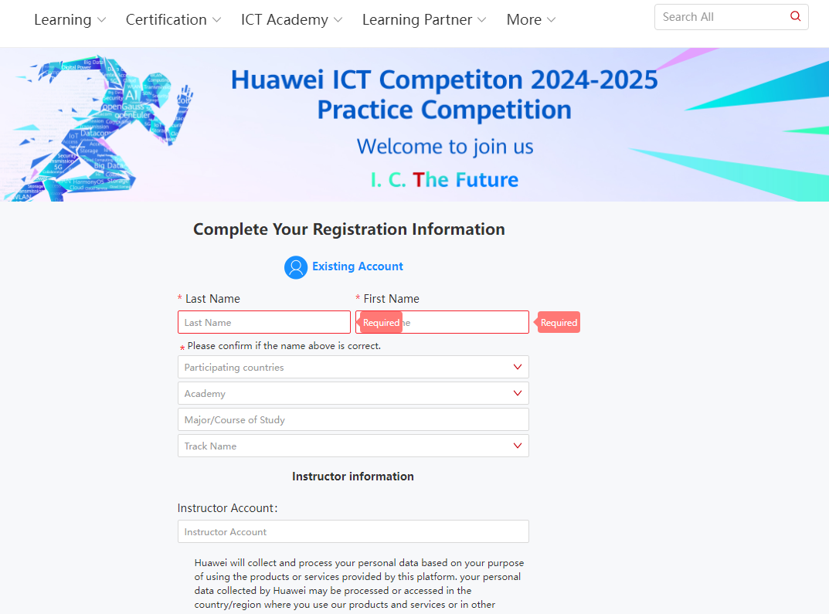
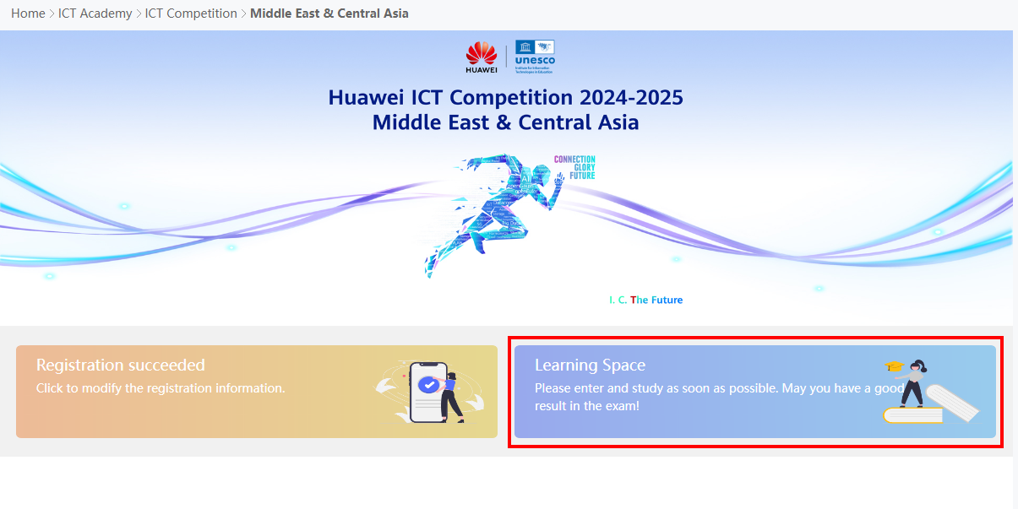
Talent Online – A Platform Supporting the ICT Competition
Step 1
Step 2
Step 3
Go to the Homepage
Complete the Registration
Online Course Learning
Home Page Links

Slide 6
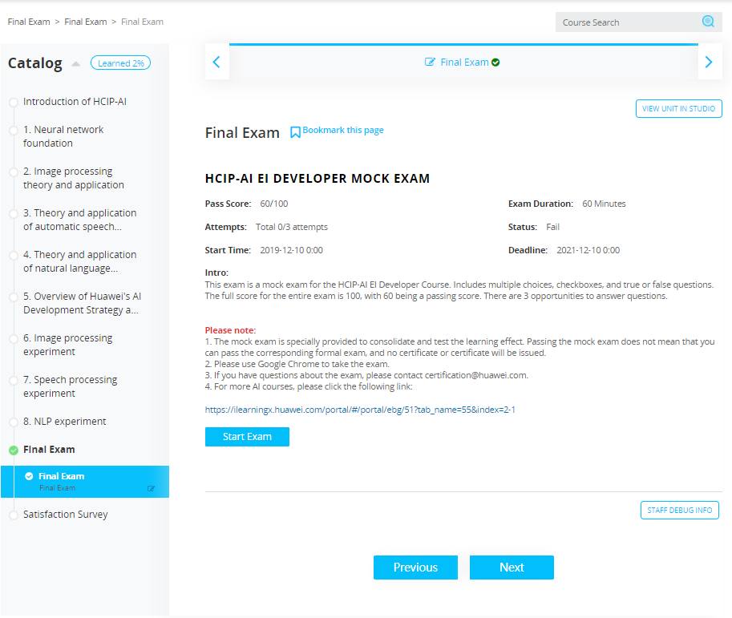
Talent Online – Online learning platform
In addition to learning in competition space, students can consolidate their knowledge through teacher class and online platform. The four steps are as follows:
https://e.huawei.com/en/talent/#/news/details?consultationId=1317
Step 1
Start to learn
Step 2
Take exam
Select “ The test " in the catalog, and follow the guidance to begin the test
Click “Start Learning" after sign up to learn the online course, including videos, textbooks, exams, and lab instructions

Slide 7
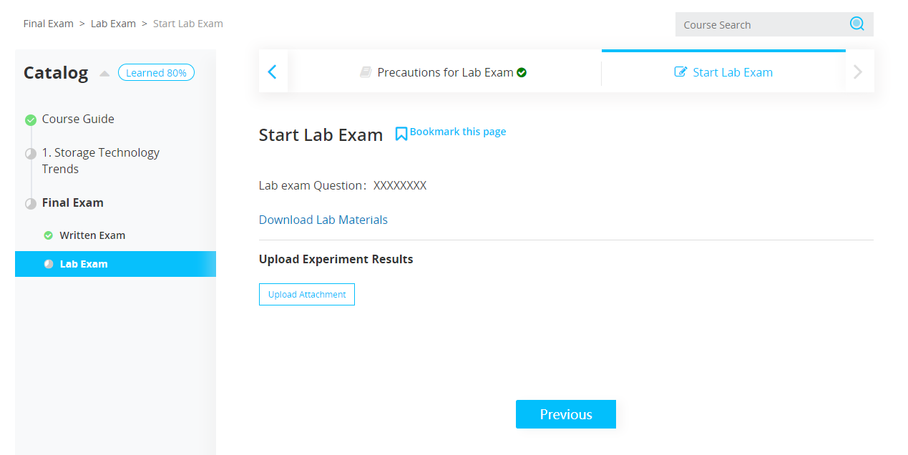
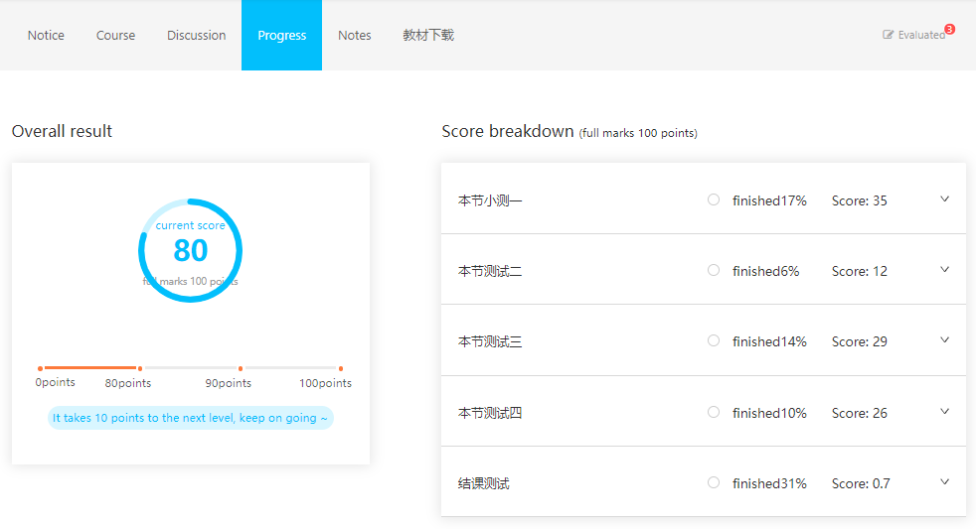
Step 3
Experiment
Select the corresponding experiment in the catalog, and then start the experiment according to the guidance.
For example, for this experiment, please download the experiment file and upload the experiment results after completion
Step 4
View score
Click “Grades" to view the score page after finishing the study

