Slide 1
Huawei ICT Competition Registration Guide
Security Level:

Slide 2
Content
1. Candidates visit ICT Competition homepage
2.1.How to register for the ICT Competition(unregistered Huawei account)
2.2. How to register for the ICT Competition(registered Huawei account)
3. Replenishment Information

Slide 3
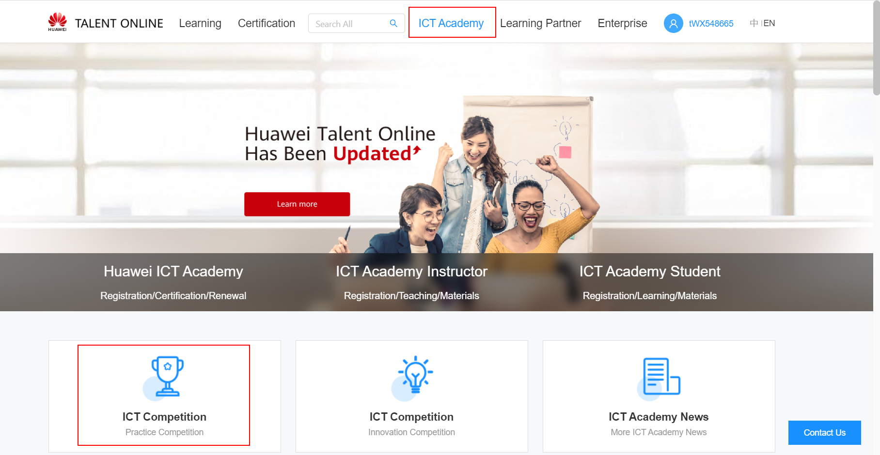
1. Candidates visit ICT Competition homepage
① Visit https://e.huawei.com/en/talent/#/ict-academy/home?navType=talentAlliance ② Click “ICT Academy-ICT Competition” to enter the ICT Competition homepage.

Slide 4
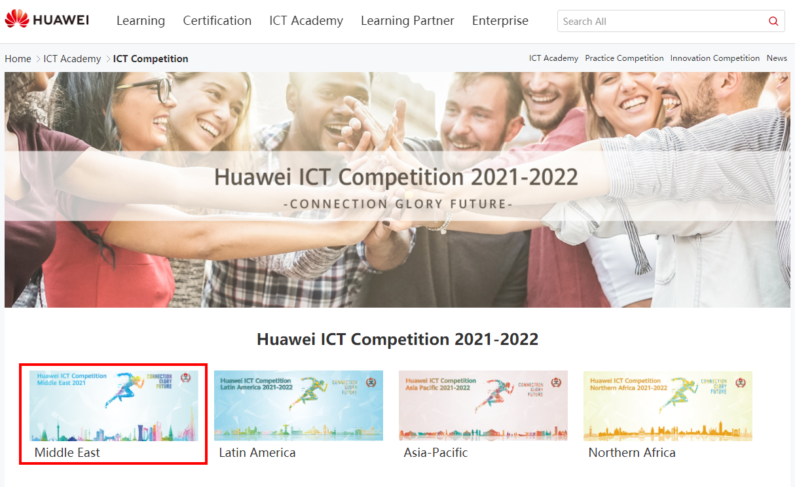
2.1 How to register for the ICT Competition(unregistered Huawei account)
Choose your regional competition.
Click“Competition Registration”to register.

Slide 5
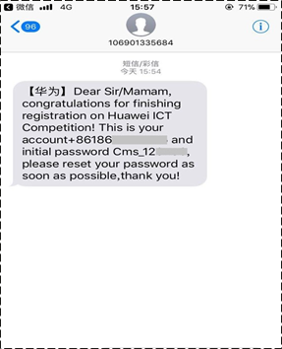
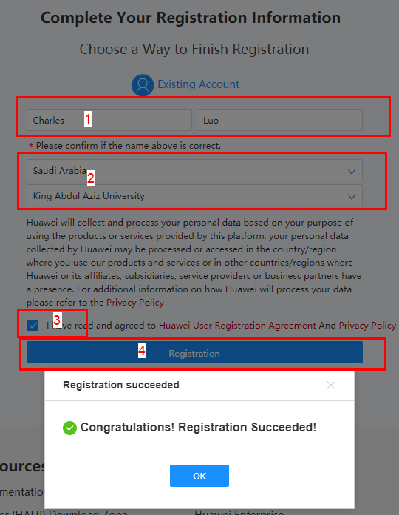
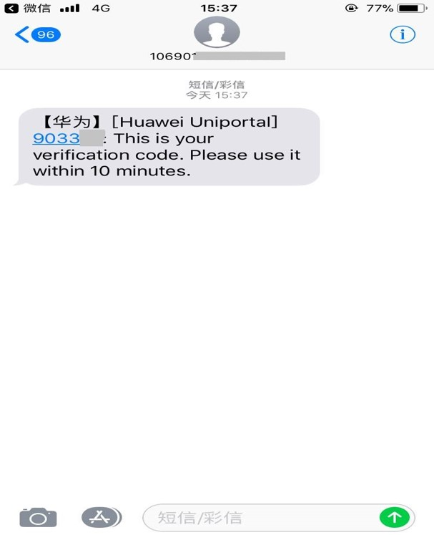
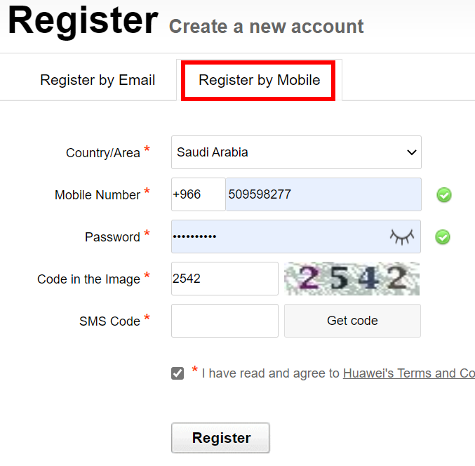
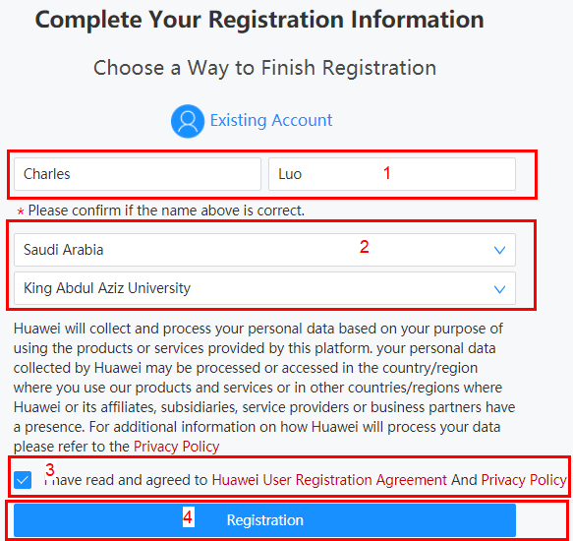
2.1. a How to register for the ICT Competition(unregistered Huawei account)-
Register by phone
Register Huawei account：Fill in your personal information - receive the mobile phone verification code
Register ICT Competition- select county and university – complete registration

Slide 6
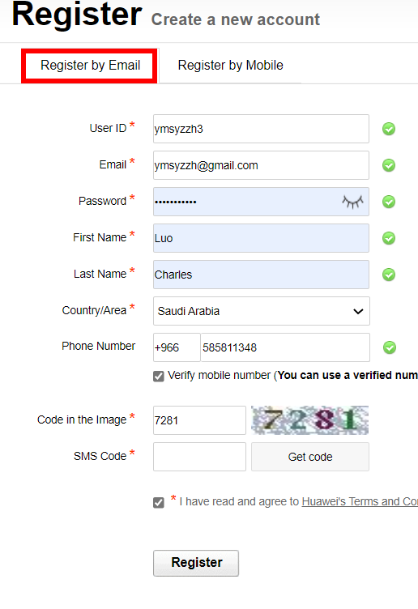
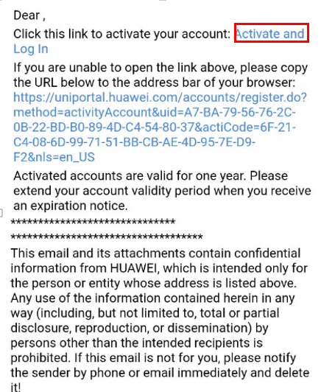
2.1. b How to register for the ICT Competition(unregistered Huawei account)-
Register by email

Slide 7
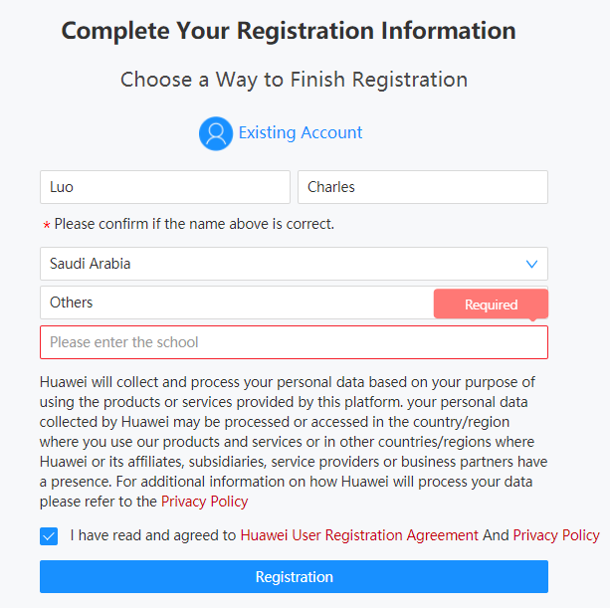
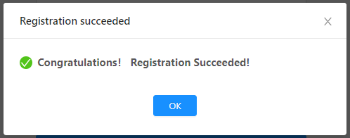
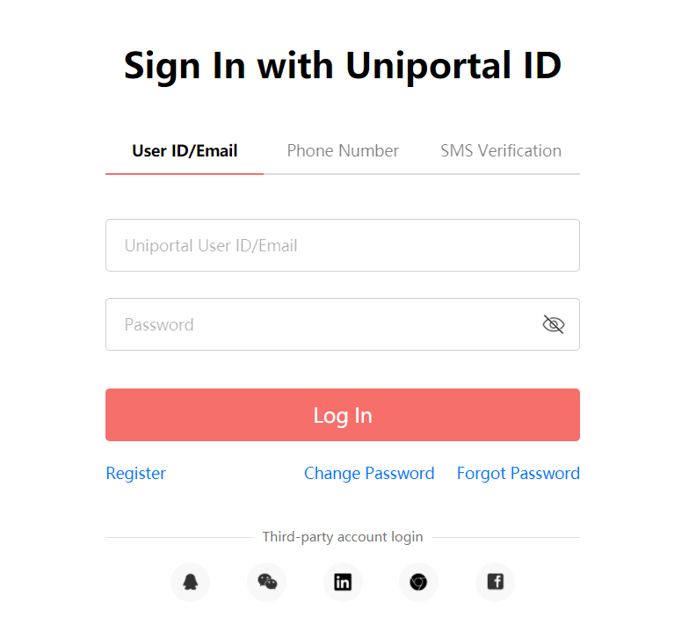
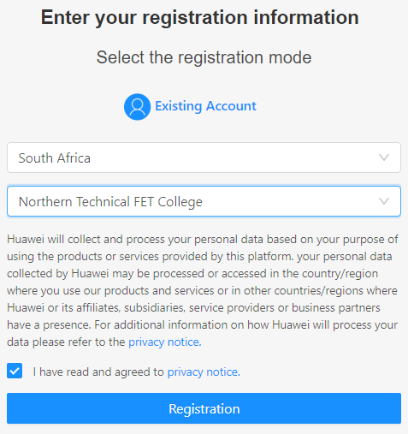
2.2 How to register for the ICT Competition(registered Huawei account)
1
5
2
3
4

Slide 8
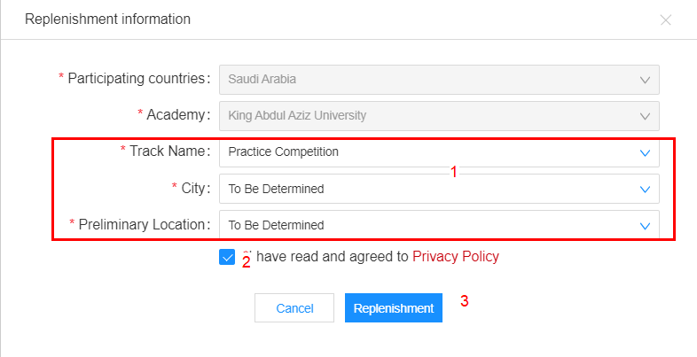
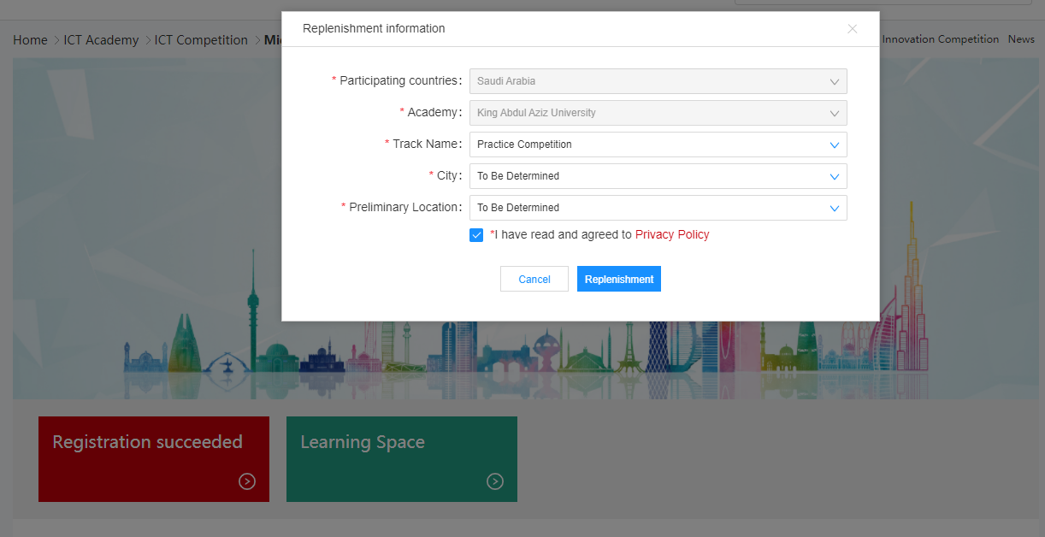
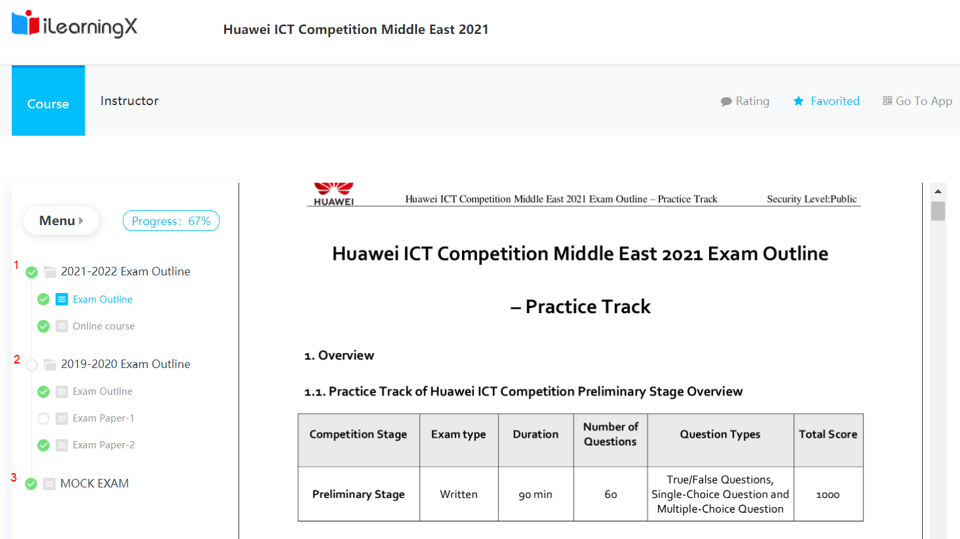
3. Replenishment Information
Complete your basic info and enter Learning Space
2
1
3

